Slide 1


Introduction to Java Script And ACMA
Precisely introduction, advantages, working of java script and difference between java script and ECMA.

Slide 2

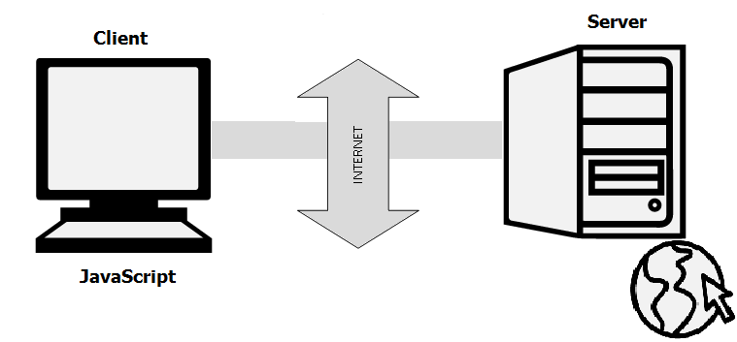
Introduction Of Java Script
Very powerful client side scripting language
Used mainly for enhancing the interaction of user with the webpage.
It can make web page more lively and interactive.
Javascript is widely used for game and application development.

Slide 3


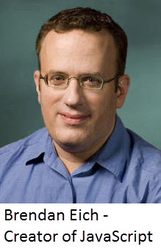



Founder of Java Script.

Slide 4
History of Java Script
Initially called as Live Script and later renamed as java script.
It is only a scripting language
The syntax of java script influenced by the programming language C.

Slide 5
Java Script Version | Version Released
1.0 | March 1996
1.1 | August 1996
1.2 | June 1997
1.3 | October 1998
1.5 | November 2000
1.6 | November 2005
1.7 | October 2006
1.8 | June 2008
1.8.1 | June 2009
1.8.2 | January 2010
1.8.5 | March 2011
Versions Of Java script

Slide 6
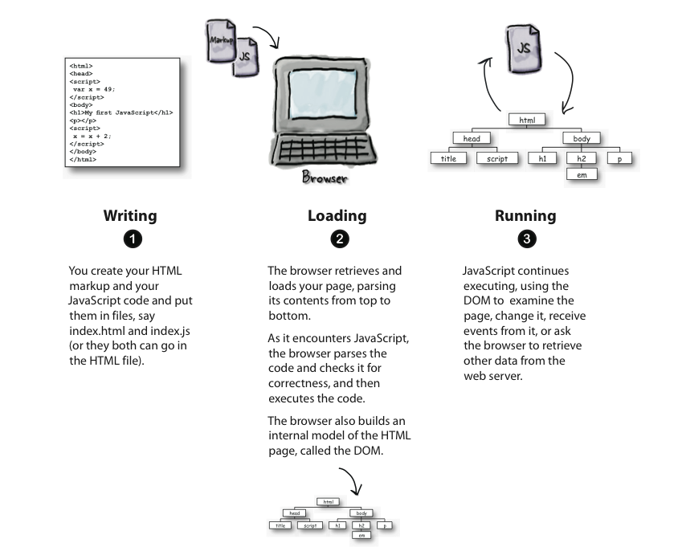
Working of Java Script

Slide 7
Advantages of Java Script
Speed | Client-side JavaScript run fast Careless from the network calls from back end server It has no need to compiled
Simplicity | Java script is simple and easy to learn and implement
Popularity | Used everywhere in web Github and Stackoverflow are considered as the good source of learning of javascript and java language.
Interoperability | JavaScript plays nicely with other languages and can be used in a huge variety of applications. Unlike PHP or SSL scripts, JavaScript can be inserted into any web page regardless of the file extension.
Server Load | It reduces server load
Rich Interfaces | Drag and drop components or slider may give a rich interface to your website.
Extended Functionality | add-ons like Greasemonkey enable JavaScript developers to write snippets of JavaScript
Versatility | it is possible to develop an entire JavaScript app from front to back using only JavaScript.
Updates | Since the advent of EcmaScript 5 (the scripting specification that Javascript relies on), Ecma International has dedicated to updating JavaScript annually

Slide 8

Thank You!

